Slide 1
Data collection: What to measure? How to measure and checking the nature of the data

Slide 2
content
Variables
Data collection: what to measure?
Data collection: how to measure?
Checking normality of data

Slide 3
Variables: What to measure?
Independent variable: A variable thought to be the cause of some effect. This term is usually used in experimental research to denote a variable that the experimenter has manipulated (e.g. Fertilizer for plant growth).
Dependent variable: A variable thought to be affected by changes in an independent variable. You can think of this variable as an outcome (e.g. Plant growth)
Predictor variable (also called Independent variable): A variable thought to predict an outcome variable (e.g. Fertilizer).
Outcome variable (also called dependent variable): A variable thought to change as a function of changes in a predictor variable (e.g Plant growth).

Slide 4
Levels of measurement: What to measure?
Binary variable: There are only two categories (e.g. dead or alive).
Nominal variable: There are more than two categories (e.g. whether someone is an omnivore, vegetarian or non-vegetarian).
Ordinal variable: The same as a nominal variable but the categories have a logical order (e.g. whether people got a fail, a pass, a merit or a distinction in their exam).
Continuous (entities get a distinct score):
  Interval variable: Equal intervals on the variable represent equal differences in the property being measured (e.g. the difference between 6 and 8 is equivalent to the difference between 13 and 15).
  Ratio variable: The same as an interval variable, but the ratios of scores on the scale must also make sense (e.g. a score of 16 on an anxiety scale means that the person is, in reality, twice as anxious as someone scoring 8).

Slide 5
Validity and reliability: is the data valid and reliable?
To ensure that measurement error is kept to a minimum make sure the validity and reliability is taken care:
  Validity: whether an instrument actually measures what it sets out to measure.
  Reliability: whether an instrument can be interpreted consistently across different situations.

Slide 6
Designs of data collection: how to measure?
Two methods of measurement (Two methods of data collection):
  (1) Manipulate the independent variable using different participants. In this method different groups of people take part in each experimental condition (a between-groups, between-subjects or independent design) or different plants are measured against effect of certain fertilizer or different cows are taken into account to measure milk production.
  (2) Manipulate the independent variable using the same participants. For e.g ask students about their happiness before food and ask same thing after food or measure plant growth before applying fertilizer and measure same thing after applying fertilizer to same plant or measure milk production from same cow before and after feeding with particular feed (within-subject or within groups or repeated measures design).

Slide 7
Data collection: how to measure? variation
There are two types of variation: Unsystematic and systematic variation
Knowing the variation of data would help you figure out how to collect the data (how to measure it)
Unsystematic variation: Difference in performance created by unknown factors (e.g. difference in performance due to dogs ability or personal ability which may not be known specifically).
  For example, difference in yield of same species of crops when grown in same soil condition or difference in milk production from same species of cow in same environmental condition.
Systematic variation: Differences in performance created by a specific experimental manipulation (e.g. dog performing differently in response to dog food or difference in performance in response to incentives).
  For example, difference in yield of same species of crops when grown in varying soil condition or difference in milk production from same species of cow when in varying environmental condition or when fed with varying feed and fodder.

Slide 8
Is the collected data distributed normally?: Checking the data
There are two types of data: Parametric and Non-parametric
Parametric data: Data with normal distribution (showing bell shaped curve).
Non-parametric data: When data are not distributed normally.
If you use parametric tests when data are non-parametric, then the results you obtained are likely to be inaccurate. Therefore, it is very important that you check your data before deciding which statistical test is appropriate.

Slide 9
Checking Normality of the data
Following numerical values and visual outputs must be investigated
  (For the data to be parametric following assumptions must be met):
Skewness and Kurtosis z values
  The values should be within the range of -1.96 and +1.96
Kolmogorov-Smirnov test and Shapiro-Wilk test p values
  Value should be above 0.05
Levene’s test
  Value should be above 0.05
Histogram, Normal Q-Q plots, and Box plots
  The plots should indicate that the data are normally distributed

Slide 10
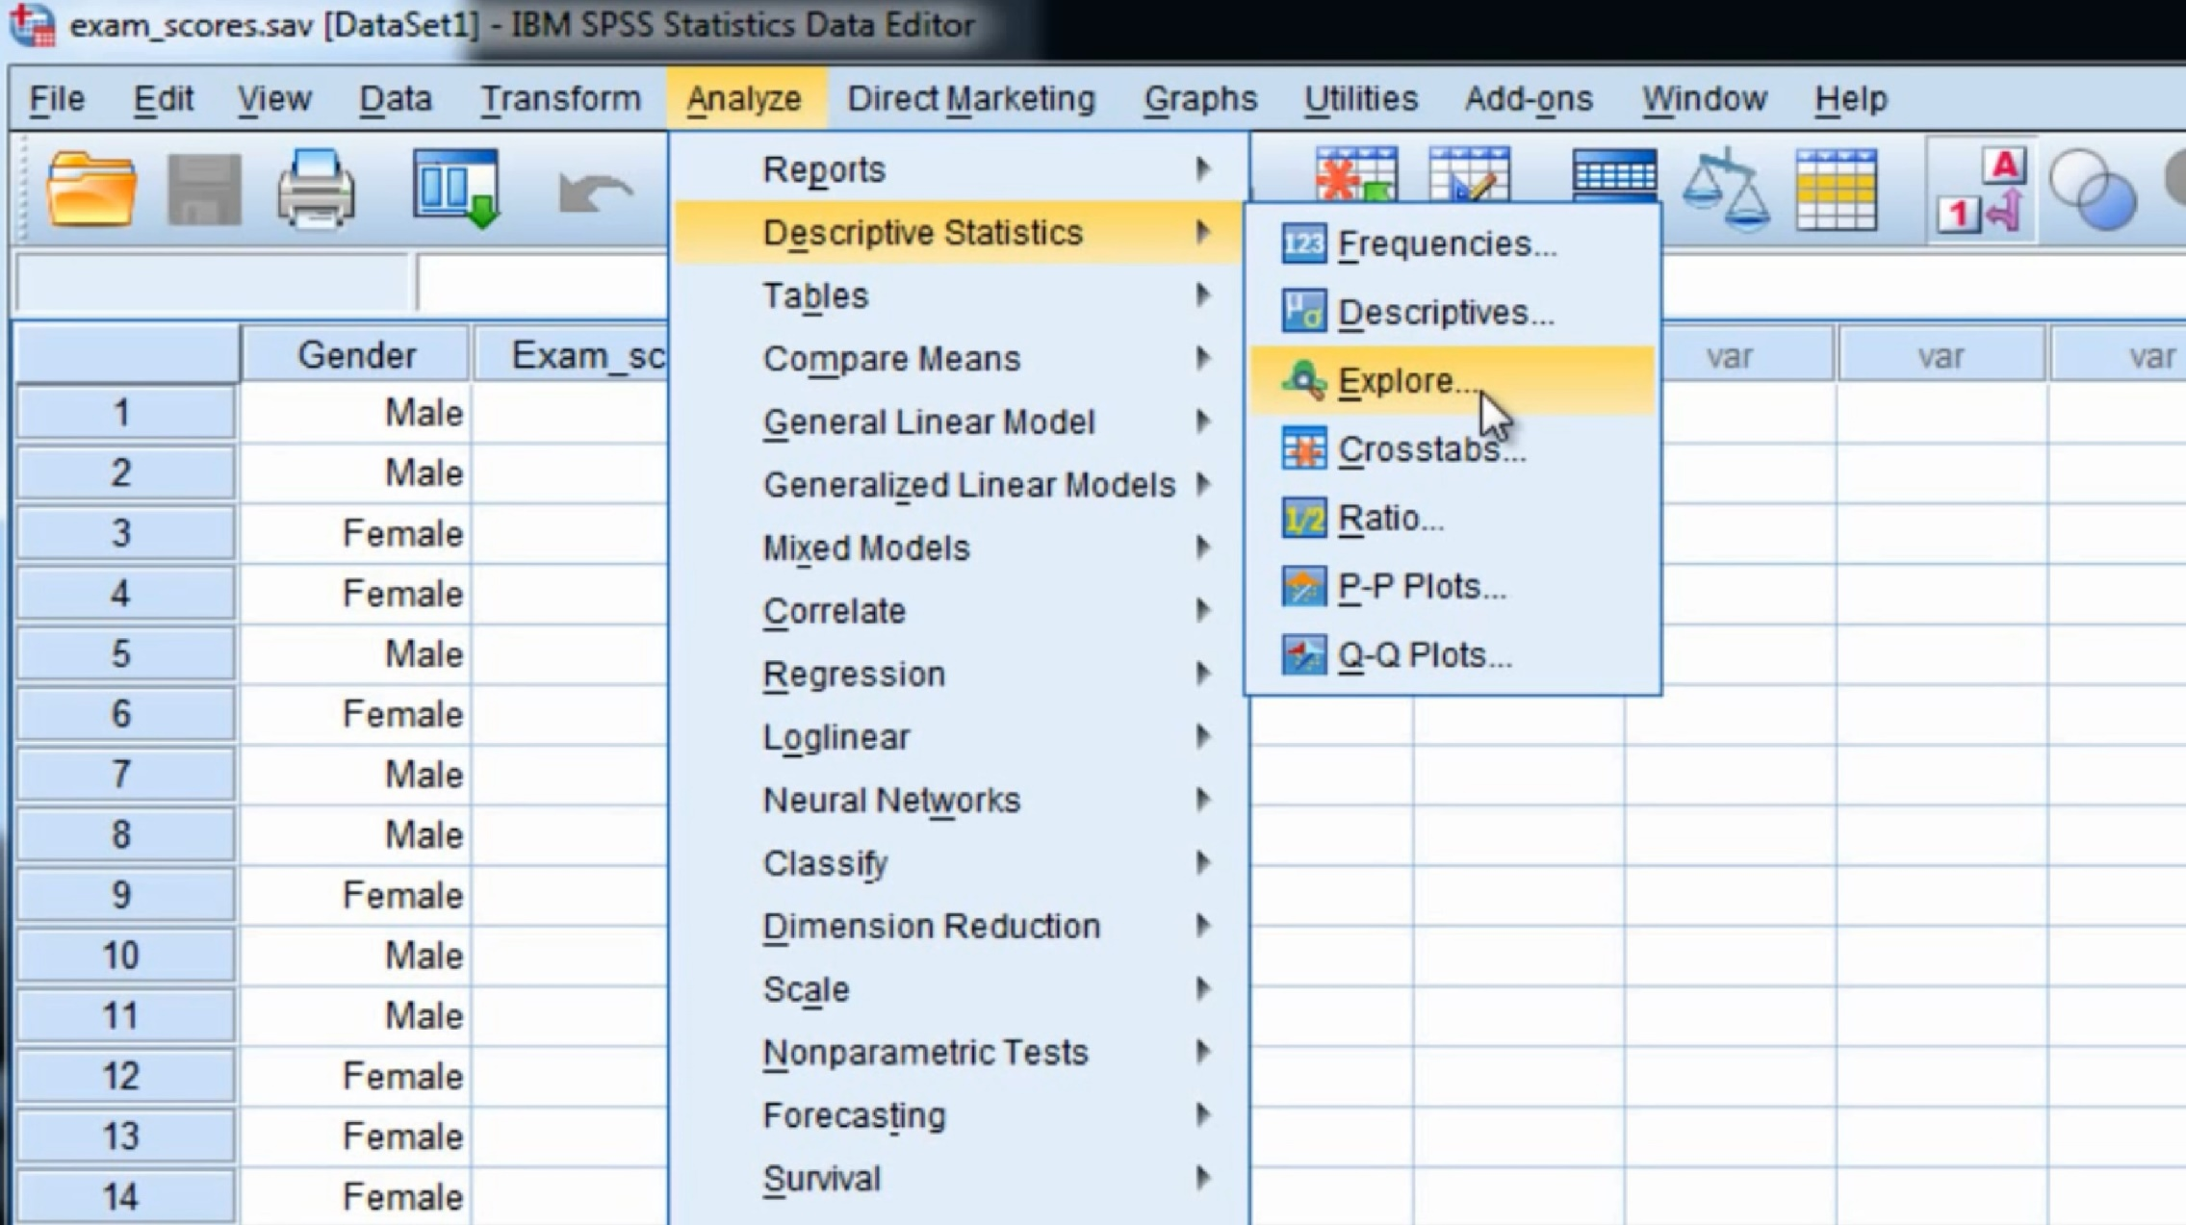
Testing for Skewness and Kurtosis
Skewness is a measure of symmetry, or the lack of symmetry. A distribution, or data set, is symmetric if it looks the same to the left and right of the center point.
Kurtosis is a measure of whether the data are peaked or flat relative to a normal distribution. Data sets with high kurtosis tend to have a distinct peak near the mean whereas low kurtosis tend to have a flat top near the mean.

Slide 11
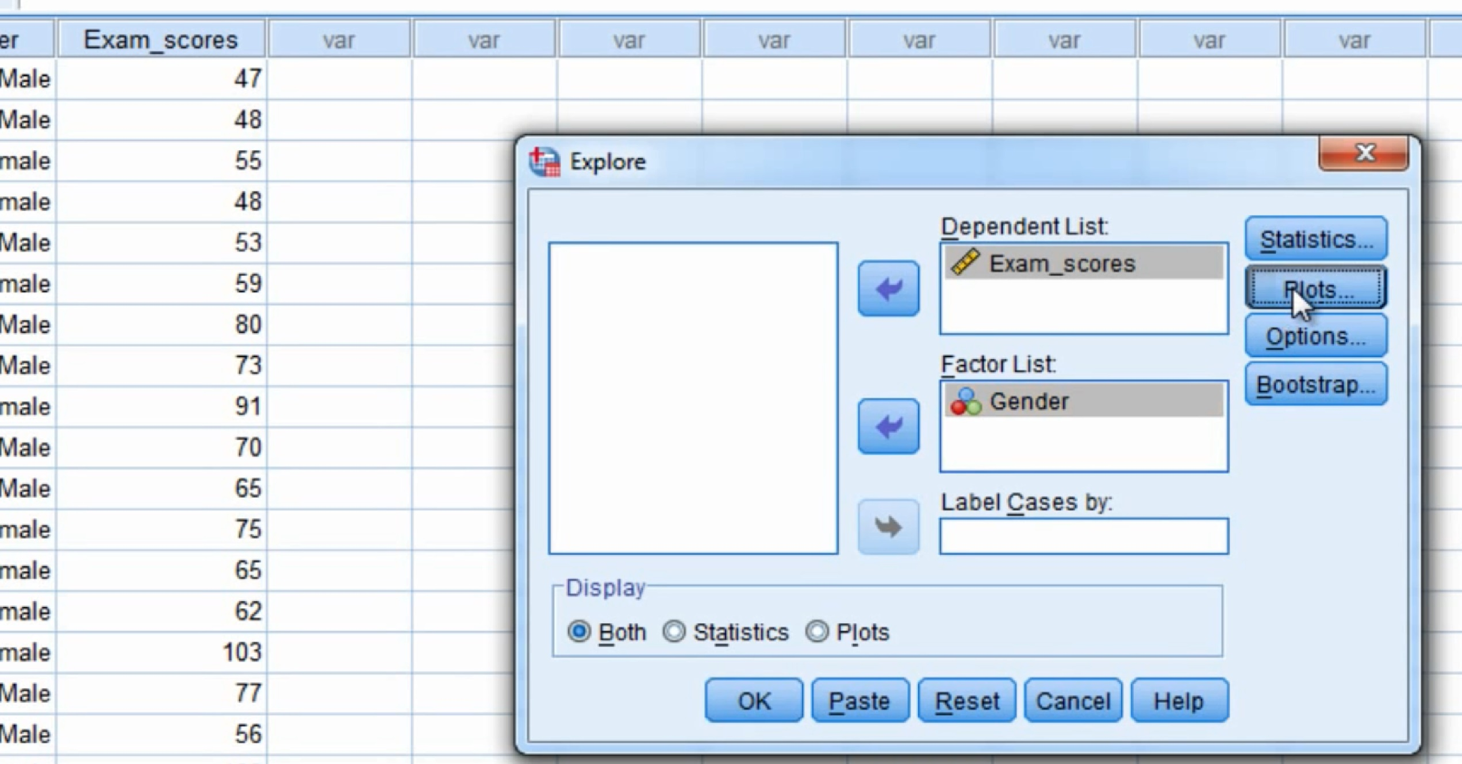
Testing for Skewness and Kurtosis

Slide 12
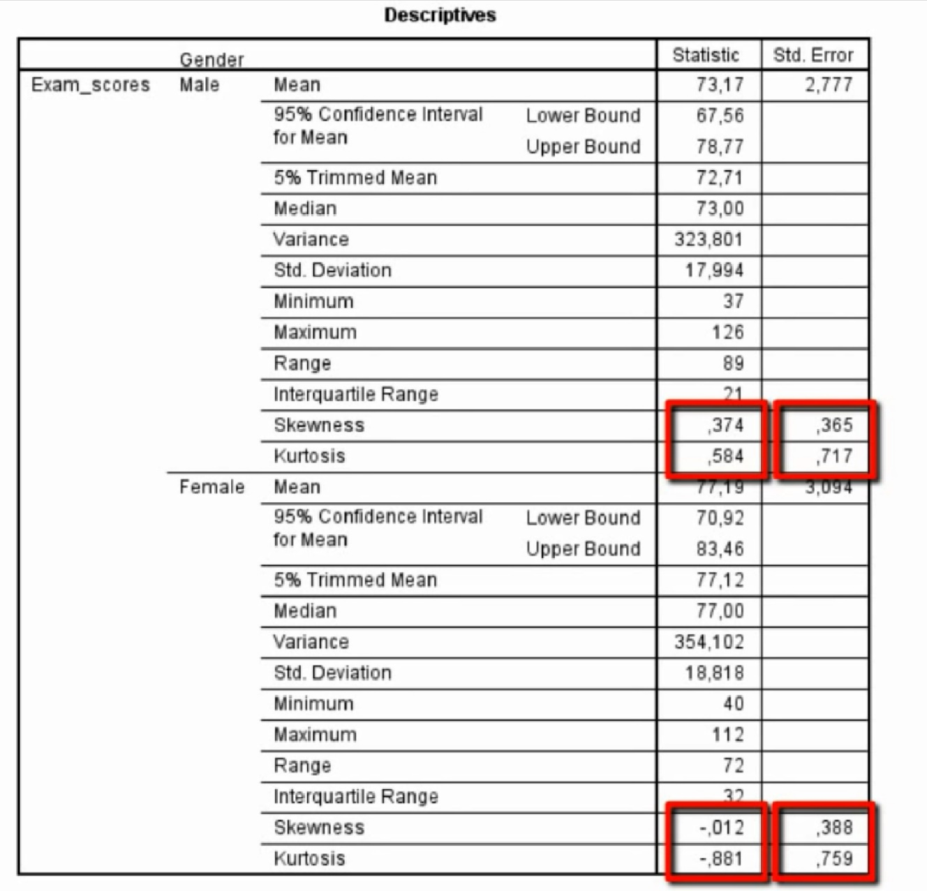
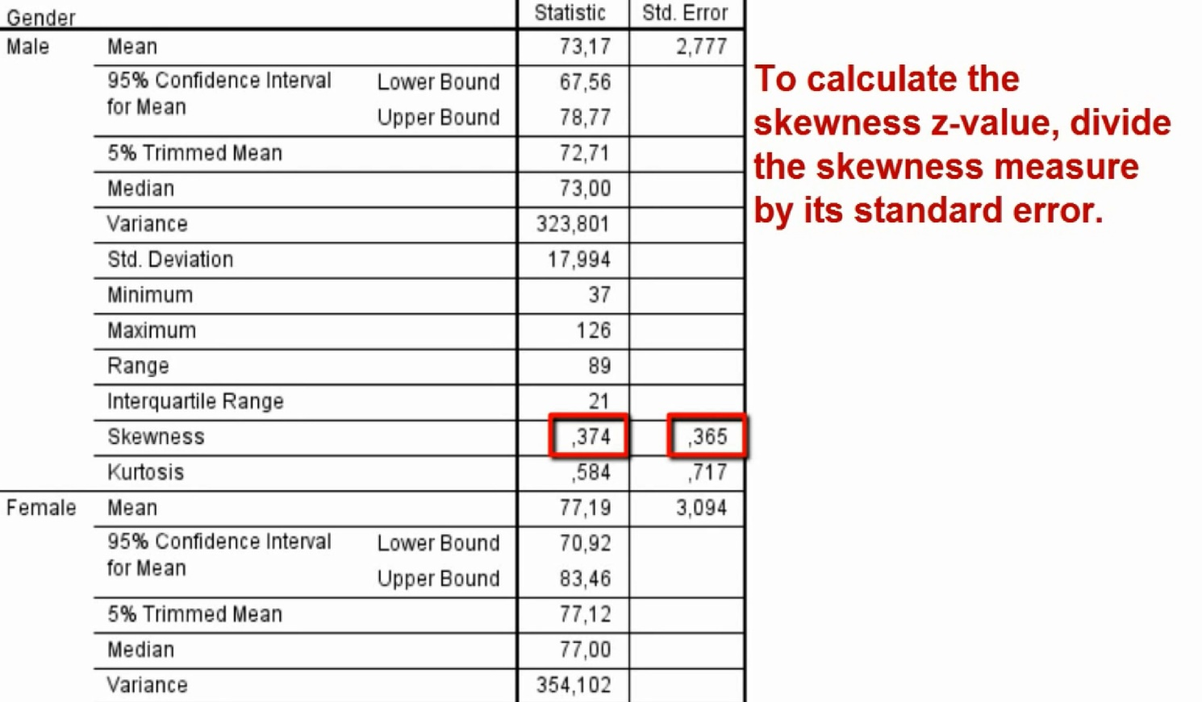
Checking the data: Skewness and Kurtosis

Slide 13
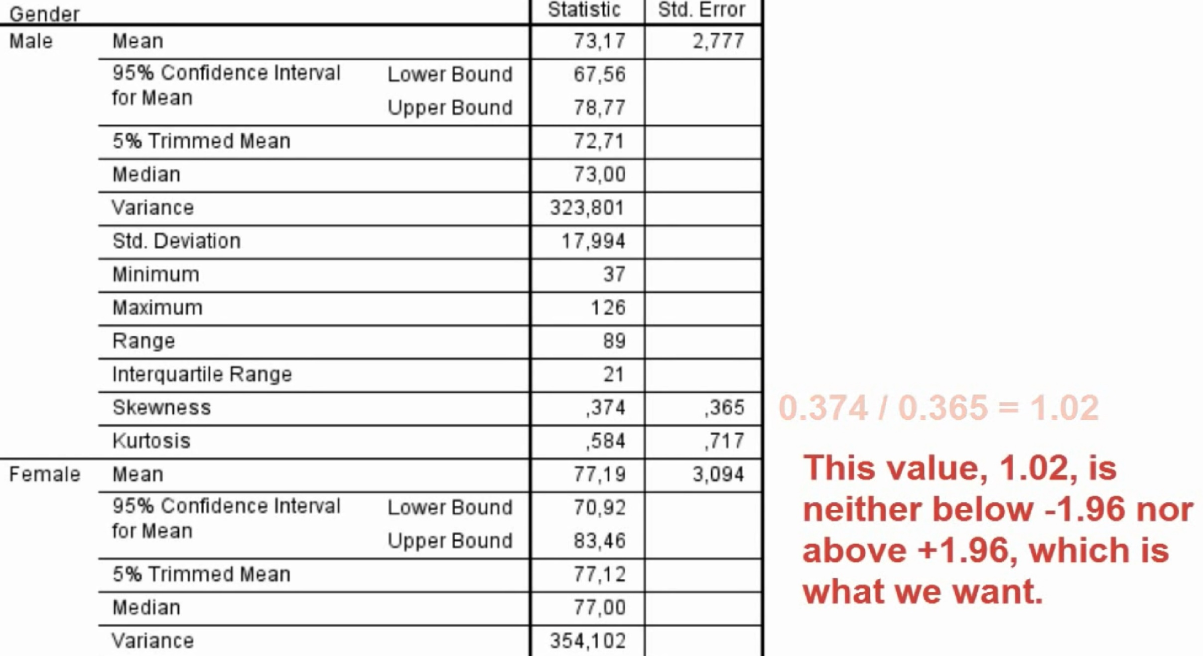
Checking the data: Skewness and Kurtosis

Slide 14
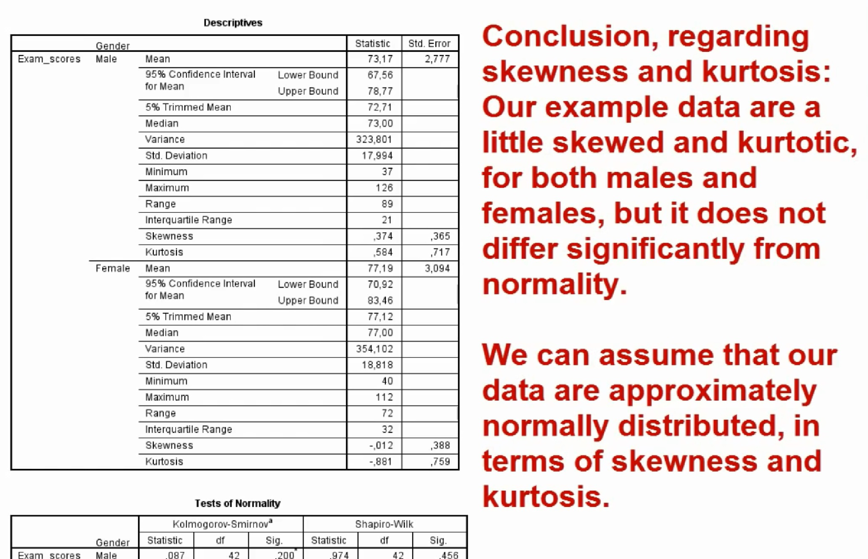
Checking the data: Skewness and Kurtosis

Slide 15
Checking the data: Kolmogorov–Smirnov test and Shapiro–Wilk test
Kolmogorov–Smirnov test and Shapiro–Wilk test: Compare the scores in the sample to a normally distributed set of scores with
the same mean and standard deviation.
If the test is non-significant (p>.05) then it tells us that the distribution of the sample is not significantly different from the normal distribution (i.e. it is probably normal).
If, however, the test is significant (p < .05) then the distribution is significantly different from a normal distribution (i.e. it is non-normal).

Slide 16
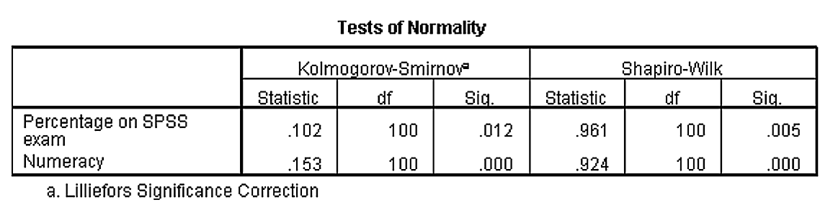
Tests of normality: Kolmogorov-Smirnov and Shapiro-Wilk tests
p-values
While reporting, also report these statistics in two decimal places
Check the whether p-values < or > .05

Slide 17
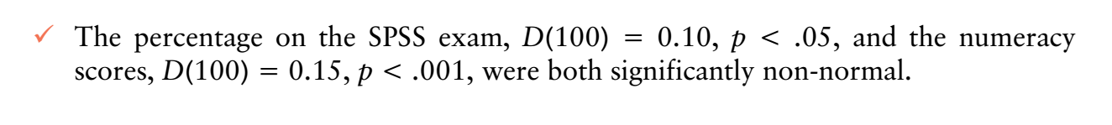
Reporting K-S test
The test statistic for the K–S test is denoted by D and you must also report the degrees of freedom (df) from the table in brackets after the D.
See below on how to report:

Slide 18
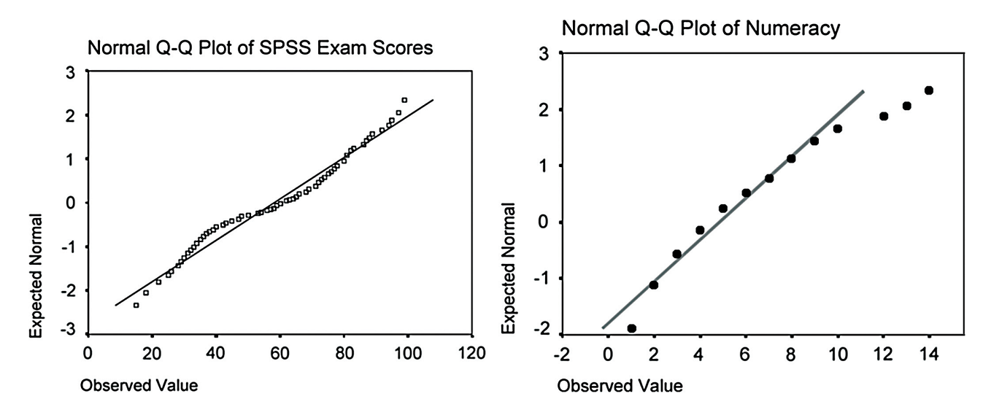
Using Q-Q plot to check normality of data

Slide 19
Levene’s test to check normality
if Levene’s test is significant at p ≤ .05 then we can conclude that
the homogeneity of variances has been violated (which means the data you have is not normal) and that the variances are significantly different.
If, however, Levene’s test is non-significant (i.e. p > .05) then the variances of your data are roughly equal to the model so the data are not different from the model (which means data are normally distributed).

Slide 20
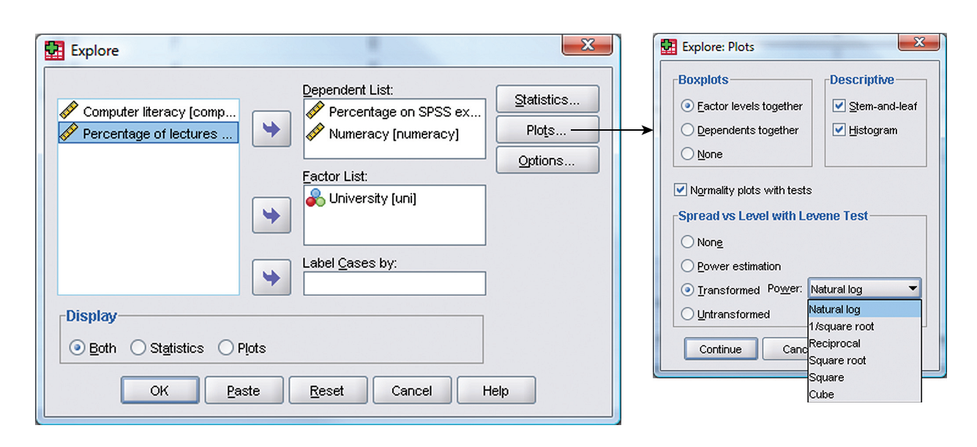
Levene’s Test

Slide 21
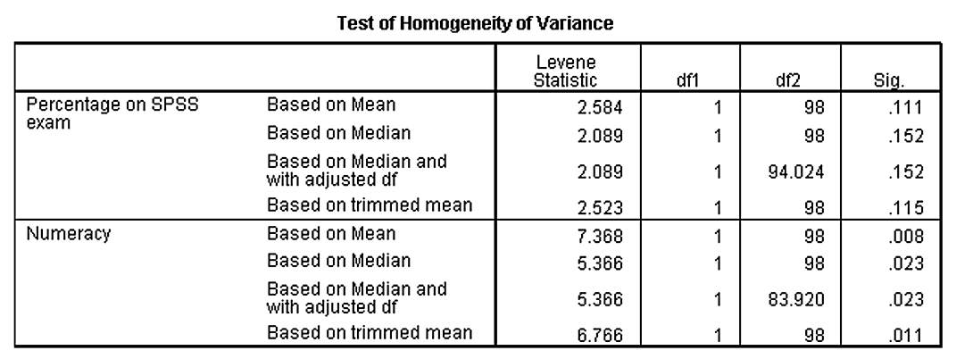
How to report Levene’s test?
Levene’s test can be denoted with the letter F and there are two different degrees of freedom. So you report in general form, as F(df1, df2) = value, sig.
Report like this: “For the percentage on the SPSS exam, the variances were equal for Duncetown and Sussex University students, F(1, 98) = 2.58, ns, but for numeracy scores the variances were significantly different in the two groups, F(1, 98) = 7.37, p < .01.”

